Slide 1

Analysis of the
National Hockey League
Craig Hatfield, Noah Folib, Brandon Gillis, Angantyr Gautason, Michael Natola

Slide 2

Introduction
We chose to do our project on hockey. We all grew up playing sports so we knew we could do our project on any sport. We thought hockey would be the most fun and interesting to report on. Also, there is a lot of data into the sport of hockey so we really found interest to the variety of statistics is has to offer. Hockey is also one of the most scientifically researched sports due to all of the injuries the players encounter while playing. Also, the physics of the sport is very interesting, being the only main sport to be played on ice.

Slide 3

Introduction
For us our main goal was to be able to successfully construct a team of the most-balanced players and coaches in hockey using different data wrangling techniques that provide us with specific statistics on players that give us enough information to make our best judgement on who to include on our team. This team is planned to be the best all-around team that can do everything on the ice.

Slide 4
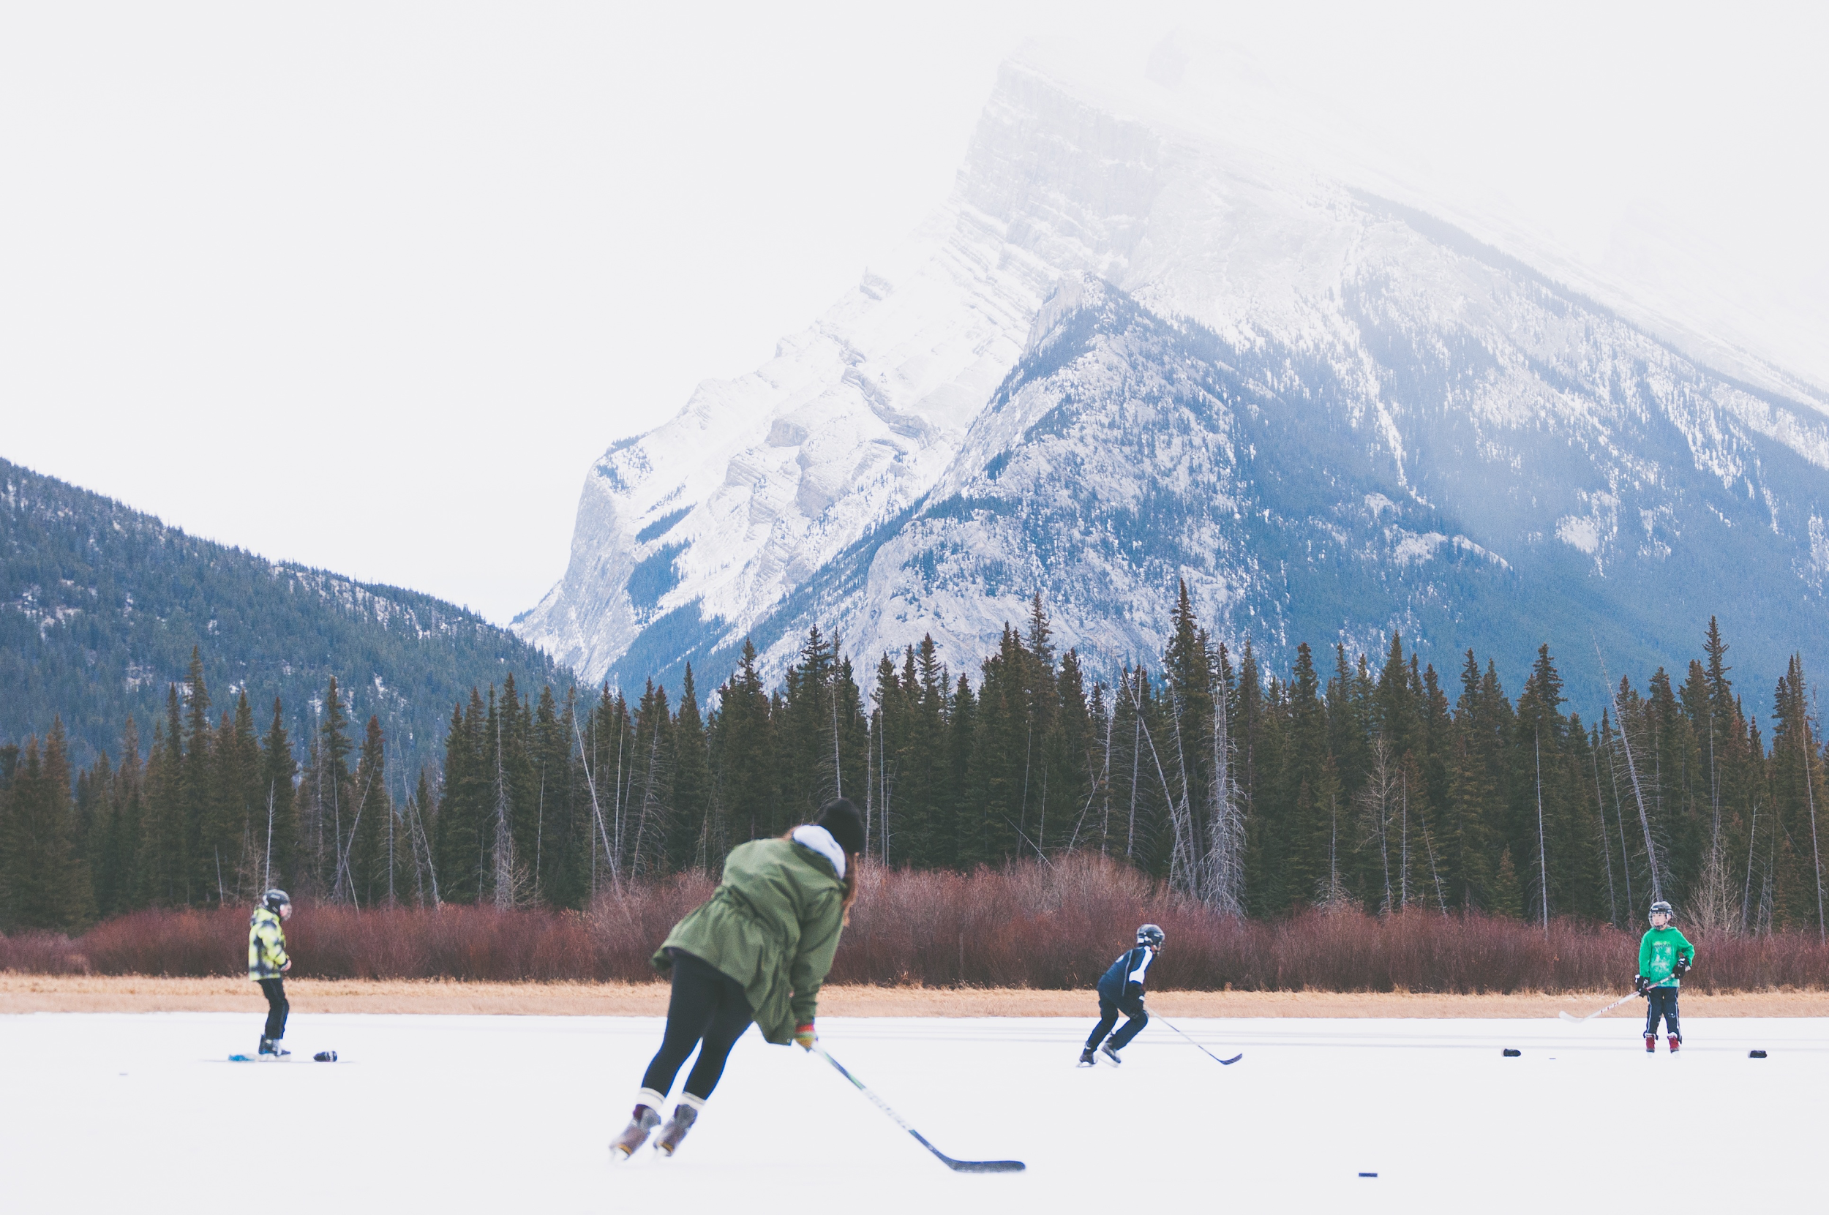

Introduction
Our data came from the website Kaggle in the form of a CSV file. It contains data from all 31 NHL teams and all of the players and coaches involved. The data that we found was collected from 1909 to 2011. The database on Kaggle that we found was huge so we used Master.csv[7761,31], AwardsPlayers.csv[2091,6], Scoring.csv[45967,31], Coaches.csv[1812,14] and Goalies.csv [4278,23] to collect our data.
Notes:
Data wrangling,
Lw and RW
Only goalies had missing values
We used mutate and left join in every question to be able to use

Slide 5
What player has the most goals,assists and points in their average season?
```{r}
# Finding the Results
d1ID <- scoring_data %>% # Assign scoring data to new variable
filter(lgID=="NHL")%>% # Filter data by players who are in the NHL
group_by(playerID) %>% # Group the data by their player ID
summarise(.groups = "drop", # Fix the ungrouping output error
Average_Goal = round(sum(G/n())),
# Average goals will be the summation of their goals divided by the # of seasons
Average_Assists = round(sum(A/n())),
# Same as ^ but with assists instead
Average_Points = round(sum(Pts/n())),) %>%
# Same as ^ but with points instead (Points is the goals + assists)
arrange(desc(Average_Points)) %>% # Arrange by the most average points
na.omit(d1ID) # Omit all Na's in dataset
# Displaying Names Instead of PlayerID
d1 <- left_join(d1ID,Players,"playerID") %>%
# Join together d1ID with Players dataset to replace PlayerID with their names
mutate(Name = paste(firstName,lastName)) %>%
# Join together the first and last name in the Players
select("Name" = Name, # Keep four variables
"Average Goals" = Average_Goal,
"Average Assists" = Average_Assists,
"Average Points" = Average_Points)
# Displaying Results
head(d1,20)
# Making Graph
ggplot(data = d1[1:5,],
# Use the top five people from the d1 dataset
aes(x = Name, # X axis is for the names
y = `Average Points`, # Y axis is for average points
fill = `Average Goals`)) + # Fill color with average goals
geom_bar(stat = "identity",
position= "dodge") +
labs(title = "Most Goals, Assists and Points",
# Make title and subtitle
subtitle = "In each players average season",
x = "Player",
y = "Number of Points") # Make x label and y label
```

Slide 6
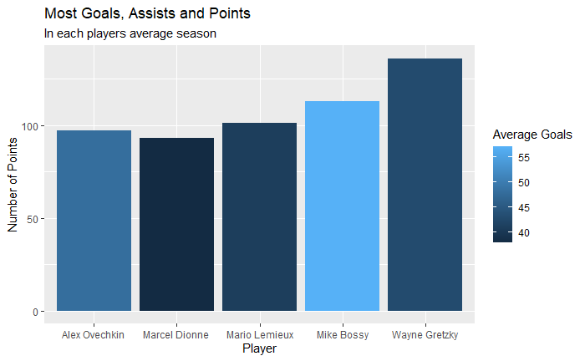


What does this show us?
Not surprisingly the best player to ever play the sport averaged the most points and assists in his career. Wayne Gretzky is known as “The Great One” for a reason and what he was able to produce on the ice will never be matched again.

Slide 7

What does this question mean to our team?
These stats are very impressive but does not provide all of the information we need to add these players to our team. The objective of our research was to build an all-around team that is the most balanced. Although scoring and assisting are very important in hockey there is more to the sport. Being a team player and providing leadership is more helpful to the team than someone who is only out there to score. However, using our results from this question we found which players were best offensively and this had a huge impact on what players were chosen for our team.

Slide 8
What defenseman scored the most points in their average season?
```{r}
# Finding the Results
d2aID <- scoring_data %>% # Assign scoring data to new variable
filter(lgID=="NHL", # Filter data by players who are in the NHL
pos=="D") %>% # And players who play defense
group_by(playerID) %>% # Group by their playerIds
summarise(.groups = "drop", # Fix the ungrouping output error
G = round(sum(G/n())),
# Average goals will be the summation of their goals divided by the # of seasons
A = round(sum(A/n())), # Same as ^ but with assists instead
Pts = round(sum(Pts/n())),) %>% # Sum up their Points
select( # Selects only the data we want to keep
playerID,G,A,Pts) %>% # Only keep playerId, Goals, Assists, and Points
arrange(desc(Pts)) # Arrange by their points
# Displaying Names Instead of PlayerID
d2a <- left_join(d2aID,Players,"playerID") %>%
# Join together d2aID with Players dataset to replace PlayerID with their names
mutate(Name = paste(firstName,lastName)) %>%
# Join together the first and last name in the Players
select("Name" = Name, # Keep four variables
"Average Goals" = G,
"Average Assists" = A,
"Average Points" = Pts)
# Displaying Results
head(d2a,20)
# Making Graph
ggplot(data = d2a[1:5,], # Use the top five people from the d2a dataset
aes(x = Name, # X axis is for the names
y = `Average Points`, # Y axis is for average points
fill = `Average Goals`)) + # Fill color with the average goals
geom_bar(stat = "identity",
position = "dodge") +
labs(title = "Most Goals, Assists and Points", # Set title and subtitle
subtitle = "In each players average season",
x = "Defensemen", # Set x and y label
y = "Number of Points")
```

Slide 9
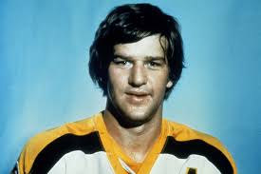
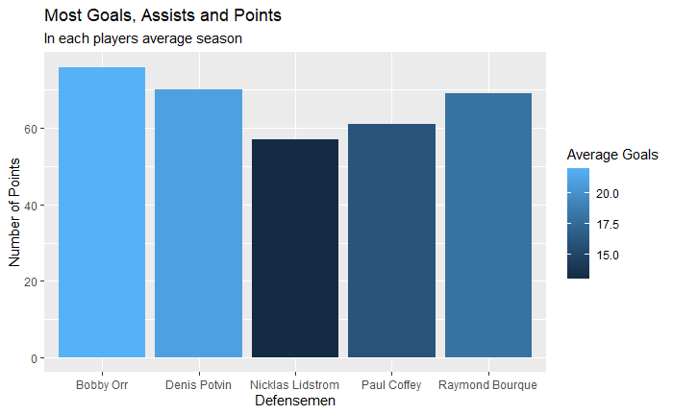
What this shows us?
We found out that the defensmen with the most average points per season was none other then Boston's own Bobby Orr. Bobby Orr was known for not only being a good scorer and an assisiter but he was known for his immaculate skating speed and ability as well as his playmaking skills.
Bobby Orr revoloutionized the position of defensmen
He wasn't only a great assister but a scorer as well averaging over 20 goals a season.

Slide 10
What this information means to us?
We are trying to figure out what all-time NHL defenseman is the best when looking at their stats
We are doing this by looking at their average points in a season throughout their career.
What are points?
Points in Hockey is there total number of goals of assists added up.
So either anytime a defenseman scores a goal or anytime the assist someone else on their team for a goal.
Why will this information help us?
Although this information does not tell us everything about a defenseman it will definitely help us find some of the best NHL defensmen of all time
But it necessarily show the best defensemen because there are so many other factors that go in like their ability to defend the puck and how they work in team.

Slide 11
What coaches have the most wins in their average season, post season and all time?
# Finding the Results
d5ID <- coaches_data %>% # Assign coaches data to new variable
filter(lgID=="NHL")%>% # Filter data by players who are in the NHL
group_by(coachID) %>% # Group the data by their coach ID
summarise(.groups = "drop", # Fix the ungrouping output error
W = round(sum(w/n())), # Average win will be the summation of their win divided by the # of seasons
postw = round(sum(postw/n()))) %>% # Same as ^ but with Post Season wins instead
mutate(ATW = W + postw) %>% # New Column Called ATW which is W + PostW
arrange(desc(ATW)) %>% # Arrange by the most average points
na.omit(d5ID) # Omit all Na's in dataset
# Displaying Names Instead of coachID
d5 <- left_join(d5ID,Coaches,"coachID") %>% # Join together d5ID with Coaches dataset to replace CoachID with their names
mutate(Name = paste(firstName,lastName)) %>% # Join together the first and last name in the Players
select("Name" = Name, # Keep four variables
"Average Seasonal Wins" = W,
"Average Post-Season Wins" = postw,
"Average All Time Wins" = ATW)
# Displaying Results
head(d5,20)
# Making Graph
ggplot(data = d5[1:5,], # Use the top five people from the d5 dataset
aes(x = Name,
y = `Average All Time Wins`,
fill = `Average Seasonal Wins`)) +
geom_bar(stat = "identity",
position= "dodge") +
labs(title = "Most Wins",
subtitle = "In each coaches average season",
x = "Coach", #name the x and y axis
y = "Total Number of Wins")

Slide 12
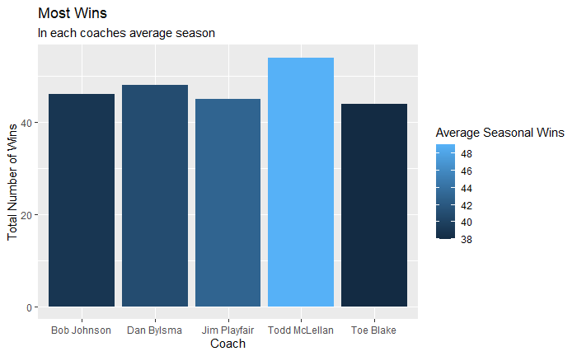
What this graph shows us
This graph shows us what coaches averaged the most wins in both regular season and postseason
The color of the graph shows us how many regular season games they averaged

Slide 13
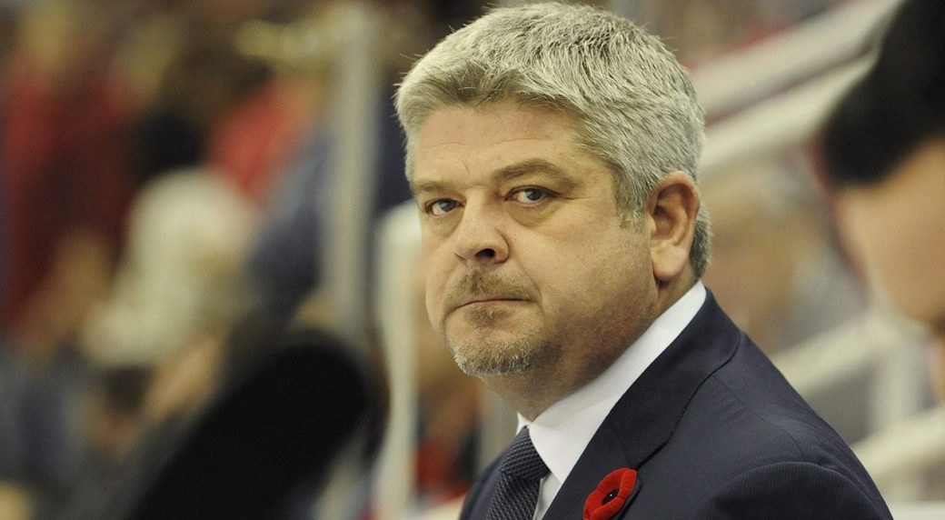
What this information told us
We needed a coach in our team
We decided to see what coaches average the most wins in both regular and postseason
How did this graph help us?
We found out what coach was the best for our team
Todd McLellan averaged most wins in total, as well as averaging most postseason wins
That is the main reason on why he was selected as our coach
This shows he was a great leader and understood the game of hockey very well

Slide 14
What goalie has the most wins in their average season, post season and all time?
#Finding the results
#Displaying Results
d6aID <- goalies_data %>% # Assign goalies data to new variable
filter(lgID=="NHL")%>% # Filter data by players who are in the NHL
group_by(playerID) %>% # Group the data by their player ID
summarise(.groups = "drop", # Fix the ungrouping output error
W = round(sum(W/n())), # Average win will be the summation of their win divided by the # of seasons
PostW = round(sum(PostW/n()))) %>% # Same as ^ but with Post Season wins instead
mutate(ATW = W + PostW) %>% # New Column Called ATW which is W + PostW
arrange(desc(ATW)) # Arrange by the most average points
head(d6a,20)
#making the graph
ggplot(data = d6a[1:5,], # Select top 5 people from d6a dataset
aes(x = Name, # x axis is for the names
y = `Average All Time Wins`, # Y axis is for average all time wins
fill = `Average Seasonal Wins`)) + # Fill color with average seasonal wins
geom_bar(stat = "identity",
position= "dodge") +
labs(title = "Most Wins", # Set title and subtitle
subtitle = "In each players average season",
x = "Goalies", # Set x label and y label
y = "Total Number of Wins")
#Displaying names instead of playerId
d6a <- left_join(d6aID,Players,"playerID") %>% # Join together d6aID with Players dataset to replace PlayerID with their names
mutate(Name = paste(firstName,lastName)) %>% # Join together the first and last name in the Players
select("Name" = Name, # Keep four variables
"Average Seasonal Wins" = W,
"Average Post-Season Wins" = PostW,
"Average All Time Wins" = ATW)

Slide 15
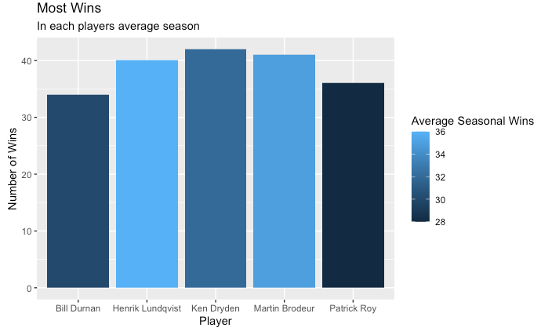
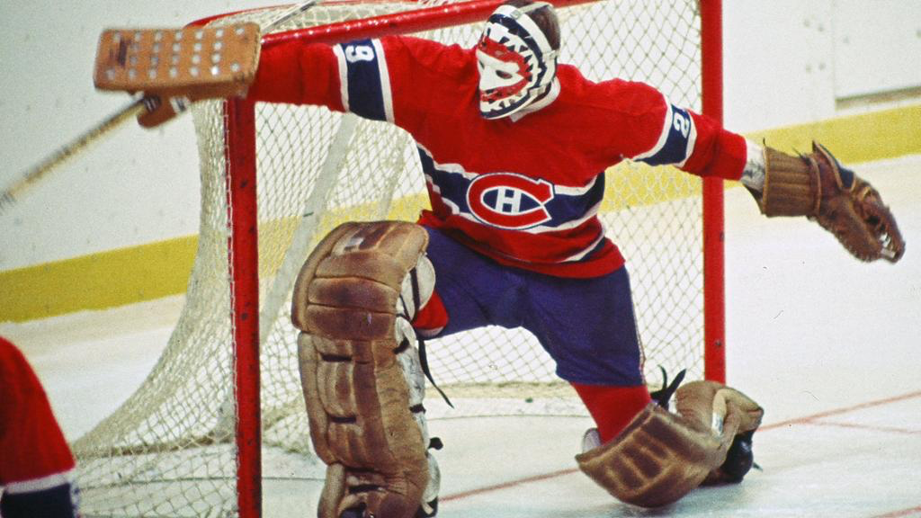
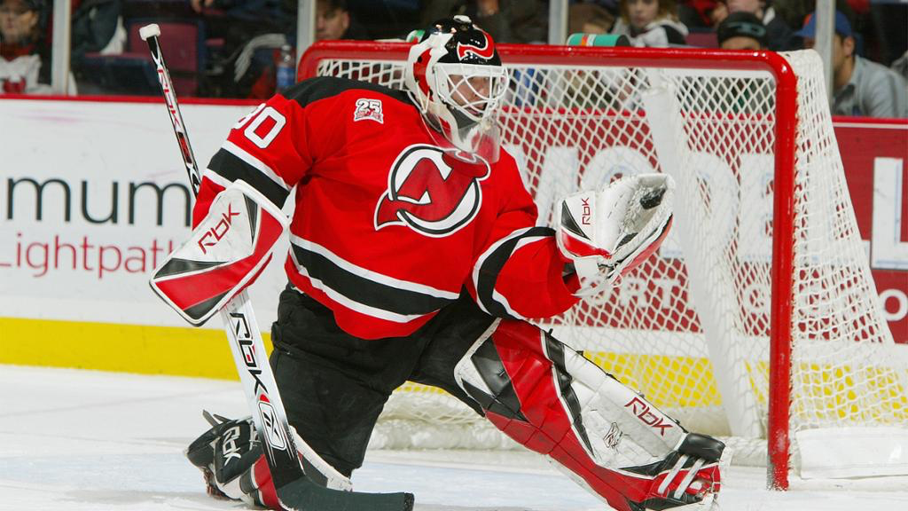
What this shows us?
This graph shows us what goalies have the most wins on average per season in both regular and postseason. A big name that didnt come as any surprise to us was Ken Dryden because based off of our preliminary findings his name was dominating the goalie data.

Slide 16

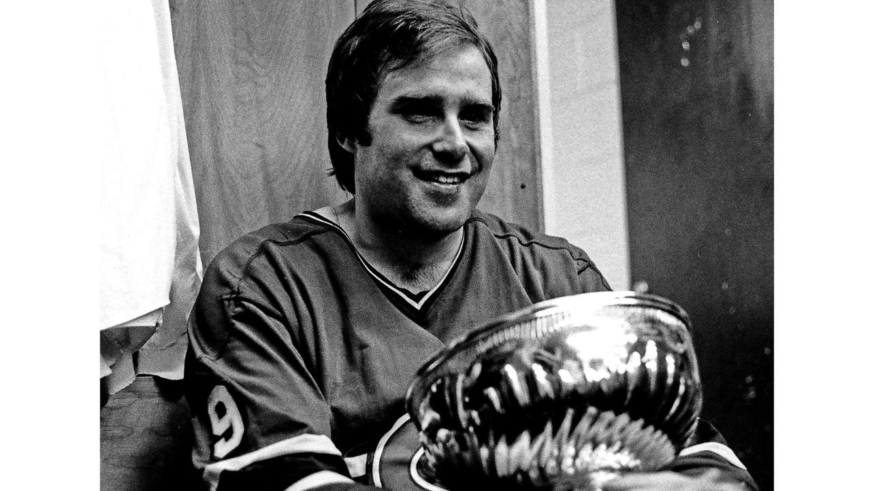
What this information means to our findings?
There is only one goalie on the ice for each team. So having a good goalie on your team is very important to winning games in hockey.
Finding the average wins based on regular season and playoff wins was very important to us because ultimately the goal for us was finding players who put up stats but also impact winning in a big way.
This Information brought us to Ken Dryden who along with Dominik Hasek headline the two goalies who would be apart of our team.

Slide 17
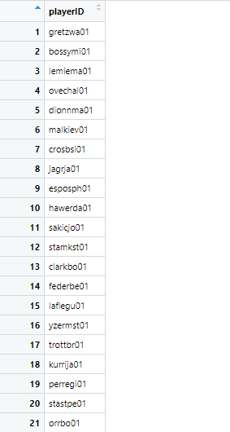
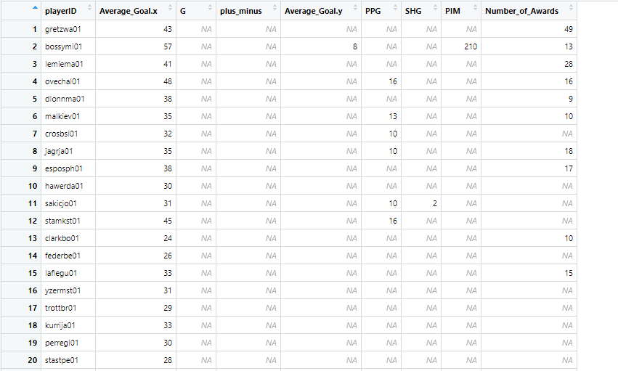
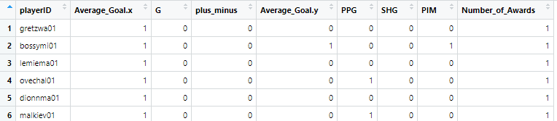
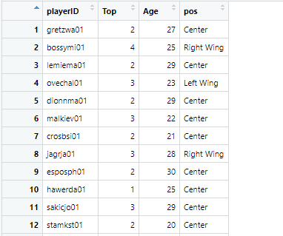
Who do we want on our team? (Code #1)
`
# Finding Final Results
d10PID <- full_join(d1ID[,1],d2aID[,1],"playerID") # d10PID (The P stands for players)
d10PID <- full_join(d10PID,d2bID[,1],"playerID") # Get each playerID that was top 50 for any category
d10PID <- full_join(d10PID,d3ID[,1],"playerID") # Only keep the playerID
d10PID <- full_join(d10PID,d4aID[,1],"playerID")
d10PID <- full_join(d10PID,d4bID[,1],"playerID")
d10PID <- full_join(d10PID,d7ID[,1],"playerID")
d10PID <- full_join(d10PID,d8ID[,1],"playerID")
d10PID <- full_join(d10PID,d1ID[1:50,1:2],"playerID") # Find the stats of each player in the list made before^
d10PID <- full_join(d10PID,d2aID[1:50,1:2],"playerID") # If the player did now make top 50 for a category we will be making the na
d10PID <- full_join(d10PID,d2bID[1:50,1:2],"playerID") # into a 0. If they did we will be making it into a 1.
d10PID <- full_join(d10PID,d3ID[1:50,1:2],"playerID") # We will tally up the stats for each player to see
d10PID <- full_join(d10PID,d4aID[1:50,1:2],"playerID") # Which good players were the most balanced.
d10PID <- full_join(d10PID,d4bID[1:50,1:2],"playerID") # We favor those who are top 50 in multiple categories rather then
d10PID <- full_join(d10PID,d7ID[1:50,1:2],"playerID") # Those who are only number one in a category
d10PID <- full_join(d10PID,d8ID[1:50,1:2],"playerID")
d10PID[,2:9][!is.na(d10PID[,2:9])] <- 1 # Make one if they are in top 50 for each category
d10PID[,2:9][is.na(d10PID[,2:9])] <- 0 # Make zero if they are not in top 50
d10PID <- cbind(d10PID, "Top" = rowSums(d10PID[,2:9])) %>% # Use cbind to sum up the rows of ones for each player
select(playerID,"Top") # Only keep the player ID and the summation of the Top 50s
d10PID <- left_join(d10PID,d9ID,"playerID") # Combine the dataset with the file that has their ages and position

Slide 18
Who do we want on our team? (Code #2)
# Best/Balanced Players
# Centers
d10CID <- d10PID %>% # Assign d10pID to d10CID (C stands for center)
filter(pos == "Center", Age <= 27) %>% # Only use centers and those ages of 27 and lower (Found in part 9)
arrange(desc(Top)) %>% # Arrange by the most top 50
head(3) %>% # Only keep Top 3
select(playerID,pos) # Only keep the variables playerID and Position
# Left Wings
d10LWID <- d10PID %>% # Assign d10pID to d10LWID (LW stands for Left Wing)
filter(pos == "Left Wing", Age <= 27) %>% # Only use centers and those ages of 27 and lower (Found in part 9)
arrange(desc(Top)) %>% # Arrange by the most top 50
head(3) %>% # Only keep Top 3
select(playerID,pos) # Only keep the variables playerID and Position
# Right Wings
d10RWID <- d10PID %>% # Assign d10pID to d10RWID (RW stands for Right Wing)
filter(pos == "Right Wing", Age <= 27) %>% # Only use centers and those ages of 27 and lower (Found in part 9)
arrange(desc(Top)) %>% # Arrange by the most top 50
head(3) %>% # Only keep Top 3
select(playerID,pos) # Only keep the variables playerID and Position
# Defense
d10DID <- d10PID %>% # Assign d10pID to d10DID (D stands for Defense)
filter(pos == "Defense", Age <= 27) %>% # Only use centers and those ages of 27 and lower (Found in part 9)
arrange(desc(Top)) %>% # Arrange by the most top 50
head(6) %>% # Only keep Top 6
select(playerID,pos) # Only keep the variables playerID and Position
# First Goalie
d10G1ID <- d6aID[1,1] # Find the goalie with the most wins
d10G1ID[1,2]<- "Goalie" # Assign Position to Goalie`
# Second Goalie
d10G2ID <- d6bID[1,1] # Find the goalie with the highest save Percent
d10G2ID[1,2]<- "Goalie" # Assign Position to Goalie
# Coach
d10ID <- d5[1,1] # Find the best coach
# Team Roster
d10 <- d10CID[1:3,1:2] # Combine the data into one team Roster
d10[4:6,1:2] <- d10LWID[1:3,1:2]
d10[7:9,1:2] <- d10RWID[1:3,1:2]
d10[10:15,1:2] <- d10DID[1:6,1:2]
d10[16,1:2] <- d10G1ID
d10[17,1:2] <- d10G2ID
d10 <- left_join(d10, # Replace all player IDs with their actual names
Players,"playerID") %>% # Combine players with d10
mutate(Name = paste(firstName,lastName)) %>% # Make a name column
select("Name" = Name, "Position" = pos) # Only keep their name and Position
# Coach Roster
d10[18,1] <- d10ID # Add coach to roster
d10[18,2] <- "Coach"
# Display results
head(d10,18)

Slide 19
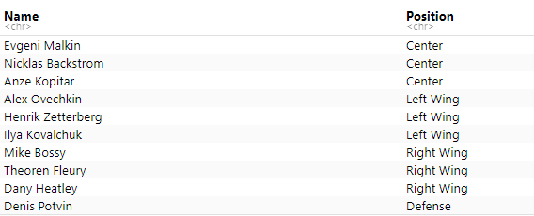
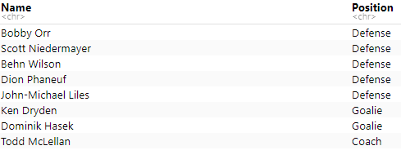
What this information told us?
We chose to have three full lines which consist of three centers, three left wings, three right wings, six defensemen, two goalies and a coach
We found that without the age requirement, our team would have changed a drastic amount. Only a few members would be the same.
These are the top 18 players who we have found to be the most balanced

Slide 20
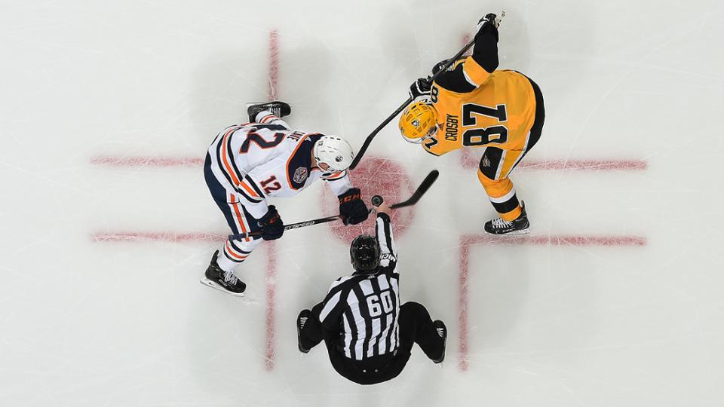
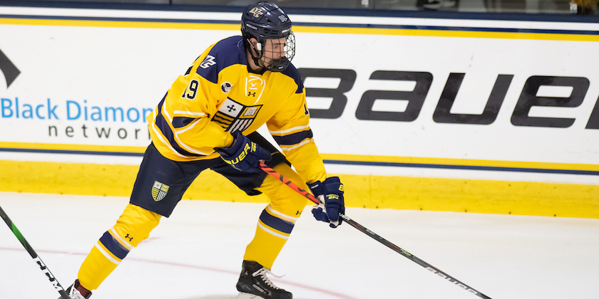
Validity and Reliability Assessment
We made sure we took multiple measures to make sure our findings were accurate. These measures included analyzing and comparing our data to other pieces of hockey data. Another measure that we took is we talked to two members of the Merrimack College hockey team(Kevin Sadovski and Filip Karlson) told us that our findings were accurate.

